Slide 1
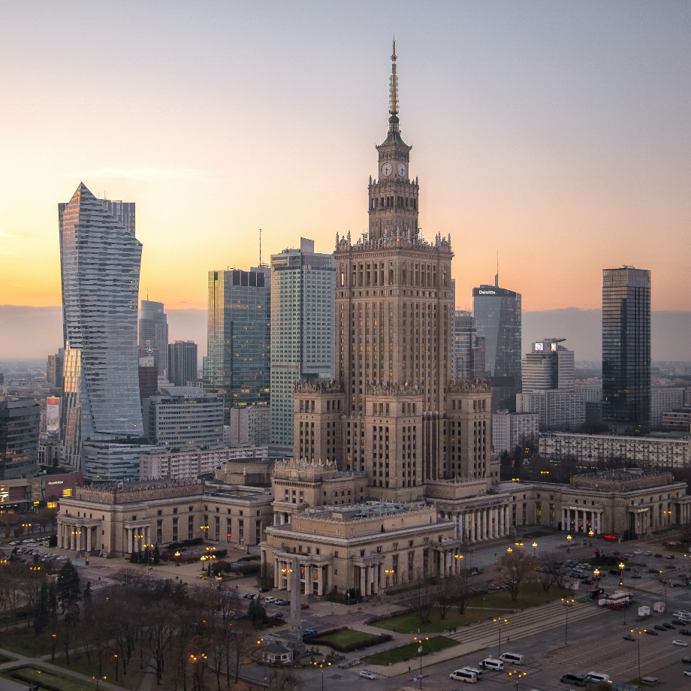
A New Era of Personalization:
How To Understand and Activate Your Customers in Real Time
Manuel Tönz
Director of Client Strategy, Bloomreach

Slide 2
Speaker
Manuel Tönz
Director of Client Strategy,
Bloomreach
Notes:
Post-covid world
Covid restrictions are gone and with it, many people are eager to travel, try new experiences, go shopping and all activities that were being restricted
Lack of economic clarity
Rise of inflation, cost of living crisis and many other things are happening that make it almost impossible to predict future behavior on the market. Studies also show that people are preferring to still invest into experiences, especially travel
Digital-first
All market segments are switching to a digital-first approach to make sure they can acquire customers from anywhere without restrictions.

Slide 3
E-Commerce Personalization
The practice of using commerce data responsibly to get to know, guide, and impress your customers with experiences that are so relevant and contextual, they feel like magic.

Slide 4
The View on Personalisation
80%
8x
90%
of customers are more likely to purchase from a company that offers personalised experiences
return on investment on marketing spend from well executed hyper-personalisation
of customers find personalised advertising appealing
Increasing personalisation improves ROI, CX, and Revenue
https://www2.deloitte.com/content/dam/Deloitte/ca/Documents/deloitte-analytics/ca-en-omnia-ai-marketing-pov-fin-jun24-aoda.pdf
Notes:
I want to start with the wider view on personalization because it is increasingly the way that brands are differentiating themselves in a crowded ecommerce market. Recent Deloitte research has shown that 80% of customers are more likely to make a purchase from a company that gives them a personalized experience. Products and recommendations are more relevant and it’s easier to find what they’re looking for.
But hyper-personalization doesn’t just bring benefits to consumers - ROI from marketing spend from well executed hyper-personalization is up to EIGHT times higher than when there is no personalization. And here, hyper personalization means not just simple rules based personalization within a single channel. Rather hyper personalization is about full, real-time 1:1 personalization that is reactive to customer behaviours as they move between channels.
And 90% of customers themselves say that they actually prefer personalized content when engaging with a brand.
All of this means that successfully implementing hyper-personalization brings benefits to your marketing ROI, your customer experience, NPS scores and even the top line.

Slide 5
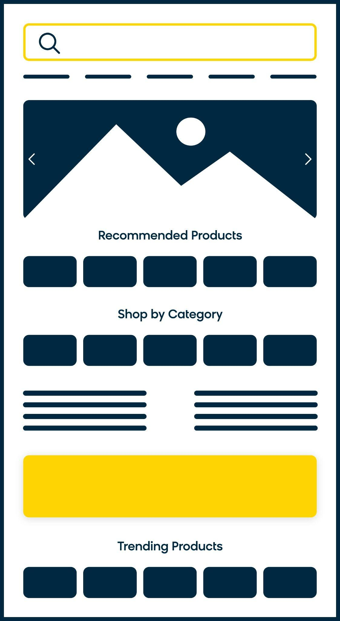
What does a hyper-personalised homepage look like?
Targeted,
strategic banners
Prominent, optimised search engine
Personalized category navigation
Relevant recommended products
Targeted editorial content marketing
Brand and benefit engagement banners
Movers and Shakers
Notes:
Meet Bloomreach Content Hub - Enrich your content marketing strategy with a content hub that builds dynamic shoppable experiences with personalized content powered by AI.
Differentiators:
Drag and drop: as the “best CMS for commerce” we help you easily add products to pages thanks to our integration with Discovery, and those products are AI-optimized, which helps you save time by not worrying about inventory levels or popularity of those products.
Feature: Pre-Built Components
Future Feature: Pre-Built Templates
Scale with personalization: rather than creating a new landing page for every campaign or landing page, the Content module helps you personalize content and products to create essentially “30,000 websites” as MKM called it. You save time by not having to build from scratch
Audience & Segment Management
Personalization on Component Level (not just full page variant)
Customer Data from Engagement
Continued Personalization (not just for Content Hub)
Optimized for SEO
These pages are naturally optimized by SEO:
Just having relevant content that is indexable by Google
Server side rendering (allowing google to index a page)
Provides structured metadata to search engines (often landing pages are island pages that are outside the main domain)
Rendering speed of pages (including image load speed). Landing pages are slower to load than regular page delivery
Feature: Content & Component Metadata
Future Feature: Fast-loading SPA including hosting
Future Feature: SEO Analytics? w/ Open UI?
Analytics to prove the value of content
We have better analytics than any CMS thanks to a deep understanding of customers and products. Engagement and Discovery
Future: Paul’s graph

Slide 6
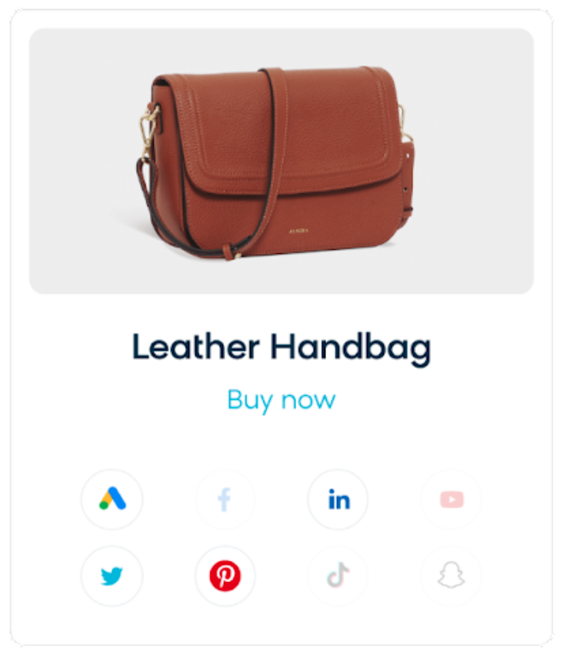
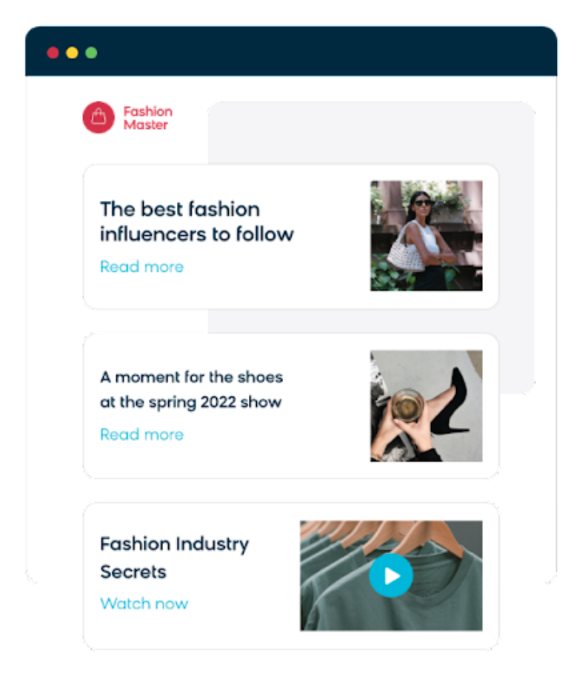
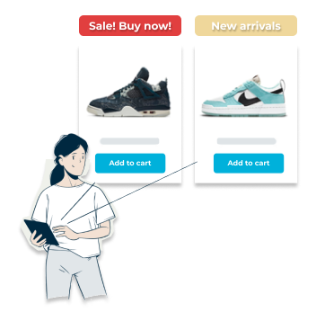
Customers Hate a Disconnected Commerce Experience
Outdated Retargeting
Irrelevant Site Content
Different Customer, Different Interests
Customer Data
Product Data
Notes:
Let’s start with the obvious. Customers hate a disconnected commerce experience. We’ve all had that experience. Receiving an email or ad for a product that you’ve already bought. Getting presented with stories and content that are not relevant to my purchase, and so on.
That dislike translates into.
Step 1: Unify your customer and product data; Step 2: activate your data in real-time across all channels

Slide 7
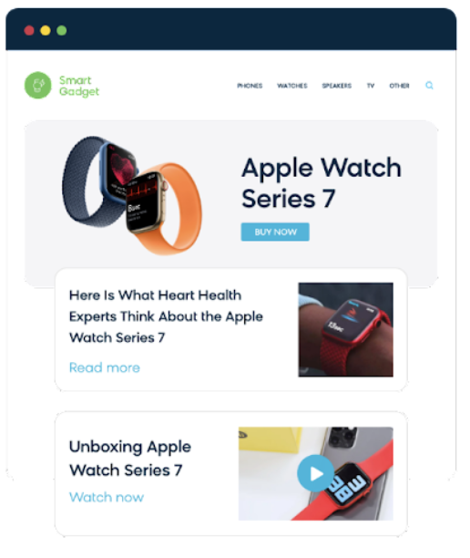
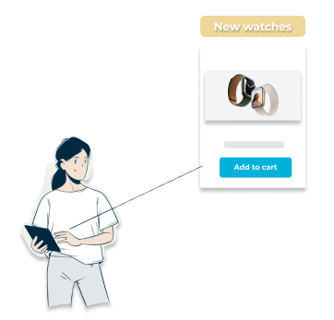
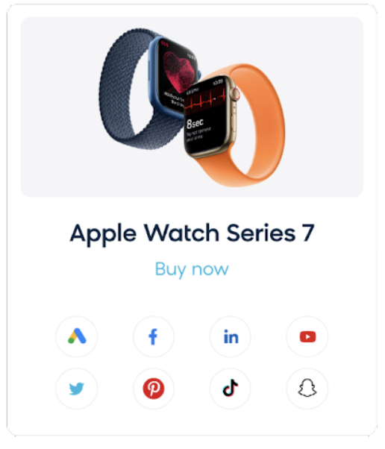
Activate Personalized Experiences with Data
Targeted Marketing
Personalized
Web Experience
Tailored Content
and Products
Customer Data
Product Data
Notes:
Let’s start with the obvious. Customers hate a disconnected commerce experience. We’ve all had that experience. Receiving an email or ad for a product that you’ve already bought. Getting presented with stories and content that are not relevant to my purchase, and so on.
That dislike translates into.
Step 1: Unify your customer and product data; Step 2: activate your data in real-time across all channels

Slide 8
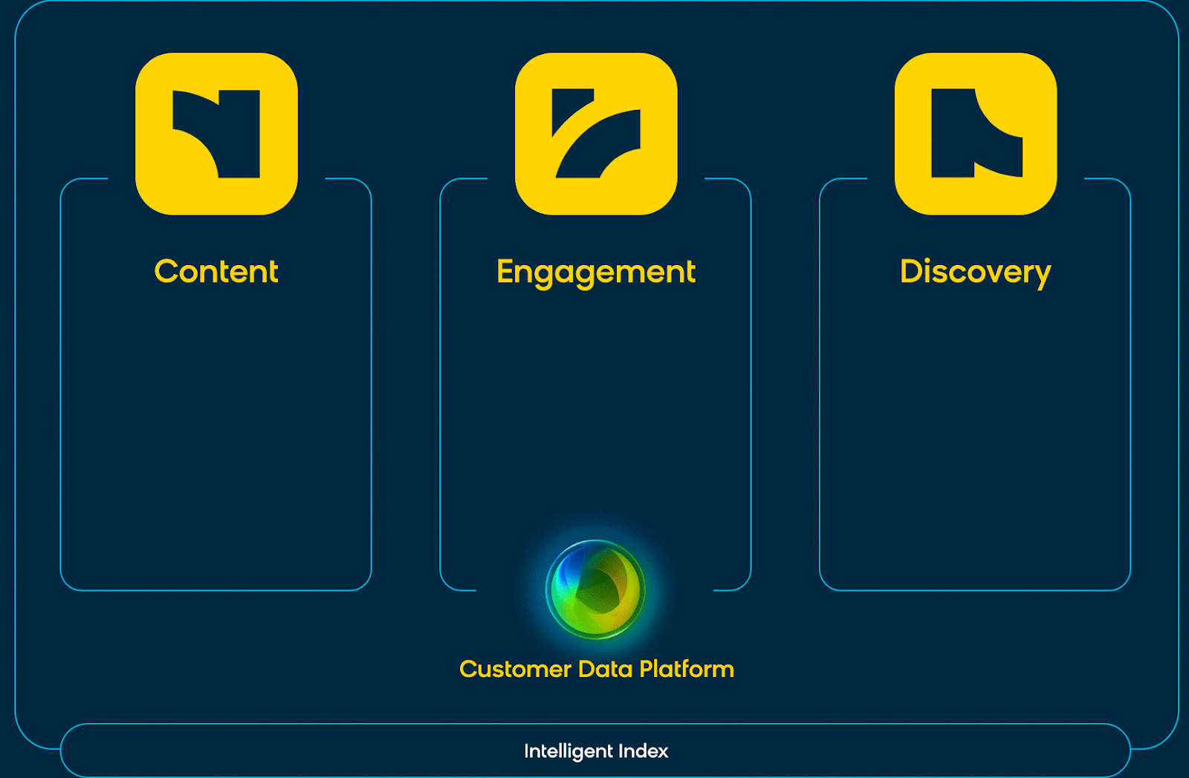
Three individually MACH certified, best-of-breed solutions.
The composable digital experience cloud built
for commerce.
Headless CMS
Visual Editor for
App & Web
Commerce Platform Connectors
Omnichannel
Marketing Automation
Single Customer View
Conversion Rate Optimisation
Onsite Search
Merchandising
Recommendations
SEO
MACH: Microservices based,
API-first,
Cloud-native SaaS,
Headless
Customer Data Engine
AI/ML to Automate Personalization at Scale

Slide 9
Bloomreach’s Answer
Irrelevant
Results
Too
Manual
No
Context
Not Tailored to my Business
Search recall is poor, even for the most basic queries
Team spends hours boosting products, creating synonyms
The products people want varies widely by person, geo, gender
Every company has different priorities. Out of the box won’t work
PROBLEM
Relevance
Engine
Optimization
Engine
Personalization
Engine
Customization
Engine
SOLUTION
Semantic Search
User Behavior
1:1 & Segment
Composite algos
Notes:
WHY THIS SLIDE: Briefly describe that Bloomreach has algorithms, “engines”, to solve for each of these use cases. Stay focused on the customer problems, but set yourself up for going into more detail later.
TALK TRACK: We’re going to keep going with search problems for awhile, but I do want to give you the punchline upfront. Bloomreach has an algorithm, an “engine”, to help with each of these major categories of search problems. They all work together to create the optimal search experience. These are:
Relevance Engine with semantic search
Optimization engine based on user behavior
Personalization engine which includes both 1:1 and a variety of segment-based personalization methods
Customization engine to be able to adapt the search engine to your needs with things like composite algorithms.

Slide 10
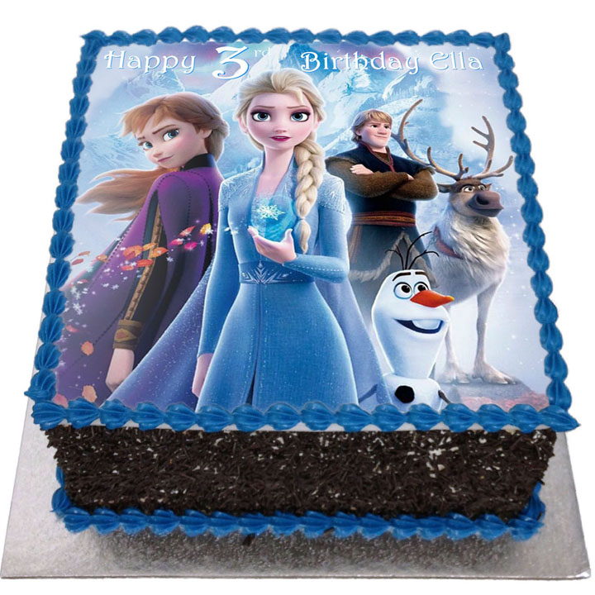
A little example…
Non-personalized
Personalized
Notes:
WHY THIS SLIDE: A good example of the manual process to create synonyms and the auto-generated synonyms that BR uses to help.
TALK TRACK: Another example here of a customer searching for a “night stand” and seeing no results, while the retailer has many end tables that would fit. Maybe no results appear, or maybe far fewer results appear than you would like.
Bloomreach returns the right results, even when the terms are off, also because of our ability to analyze user behavior. If enough people type “night stand” and navigate to the right “end table” products, we’ll see it and create a synonym on your behalf.

Slide 11
Bloomreach’s Answer
Irrelevant
Results
Too
Manual
No
Context
Not Tailored to my Business
Search recall is poor, even for the most basic queries
Team spends hours boosting products, creating synonyms
The products people want varies widely by person, geo, gender
Every company has different priorities. Out of the box won’t work
PROBLEM
Relevance
Engine
Optimization
Engine
Personalization
Engine
Customization
Engine
SOLUTION
Semantic Search
User Behavior
1:1 & Segment
Composite algos
Notes:
WHY THIS SLIDE: Briefly describe that Bloomreach has algorithms, “engines”, to solve for each of these use cases. Stay focused on the customer problems, but set yourself up for going into more detail later.
TALK TRACK: We’re going to keep going with search problems for awhile, but I do want to give you the punchline upfront. Bloomreach has an algorithm, an “engine”, to help with each of these major categories of search problems. They all work together to create the optimal search experience. These are:
Relevance Engine with semantic search
Optimization engine based on user behavior
Personalization engine which includes both 1:1 and a variety of segment-based personalization methods
Customization engine to be able to adapt the search engine to your needs with things like composite algorithms.

Slide 12
Male
Early 30s
iPhone
New York
Macbook
Works in tech
2nd Party

Slide 13
Male
Early 30s
iPhone
New York
Macbook
Works in tech
Male
Early 30s
iPhone
Denver
Macbook
Works in tech
2nd Party

Slide 14
Male
Early 30s
iPhone
New York
Macbook
Works in tech
Male
Early 30s
iPhone
Denver
Macbook
Works in tech
Male
Early 30s
iPhone
New York
Macbook
Works in tech
2nd Party

Slide 15
Male
Early 30s
iPhone
New York
Macbook
Works in tech
Male
Early 30s
iPhone
Denver
Macbook
Works in tech
Male
Early 30s
iPhone
New York
Macbook
Works in tech
2nd Party
Luxury goods & items
Purchased higher priced items
Mobile first
1st Party

Slide 16
Male
Early 30s
iPhone
New York
Macbook
Works in tech
Male
Early 30s
iPhone
Denver
Macbook
Works in tech
Male
Early 30s
iPhone
New York
Macbook
Works in tech
2nd Party
Luxury goods & items
Purchased higher priced items
Mobile first
Cares about functionality
4.5 stars or higher
Research first
1st Party

Slide 17
Male
Early 30s
iPhone
New York
Macbook
Works in tech
Male
Early 30s
iPhone
Denver
Macbook
Works in tech
Male
Early 30s
iPhone
New York
Macbook
Works in tech
2nd Party
Luxury goods & items
Purchased higher priced items
Mobile first
Cares about functionality
4.5 stars or higher
Research first
Loyalty member to save $$$
Checks out best sellers
Adds to cart but decides to wait
1st Party

Slide 18
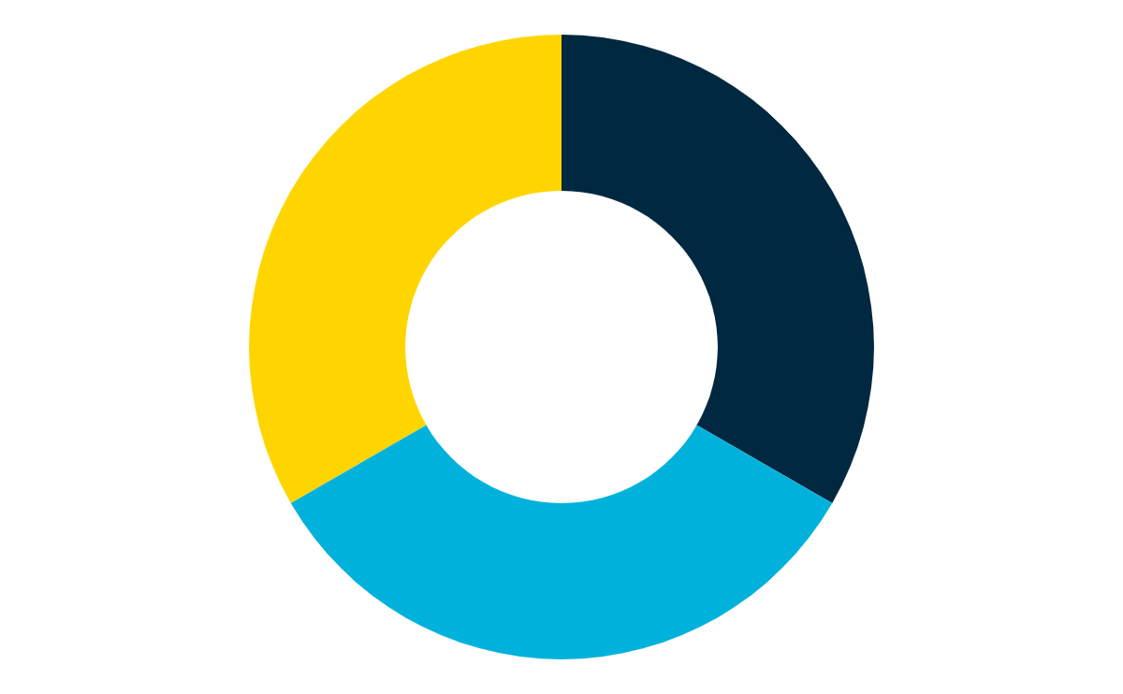
Male
Early 30s
iPhone
New York
Macbook
Works in tech
Male
Early 30s
iPhone
Denver
Macbook
Works in tech
Male
Early 30s
iPhone
New York
Macbook
Works in tech
2nd Party
Luxury goods & items
Purchased higher priced items
Mobile first
Cares about functionality
4.5 stars or higher
Research first
Loyalty member to save $$$
Checks out best sellers
Adds to cart but decides to wait
1st Party
Zero Party
Email address
Phone number

Slide 19
Male
Early 30s
iPhone
New York
Macbook
Works in tech
Male
Early 30s
iPhone
Denver
Macbook
Works in tech
Male
Early 30s
iPhone
New York
Macbook
Works in tech
2nd Party
Luxury goods & items
Purchased higher priced items
Mobile first
Cares about functionality
4.5 stars or higher
Research first
Loyalty member to save $$$
Checks out best sellers
Adds to cart but decides to wait
1st Party
Prefers in-store
Sets an appointment
Email address
Zero Party
Email address
Phone number

Slide 20
Male
Early 30s
iPhone
New York
Macbook
Works in tech
Male
Early 30s
iPhone
Denver
Macbook
Works in tech
Male
Early 30s
iPhone
New York
Macbook
Works in tech
2nd Party
Luxury goods & items
Purchased higher priced items
Mobile first
Cares about functionality
4.5 stars or higher
Research first
Loyalty member to save $$$
Checks out best sellers
Adds to cart but decides to wait
1st Party
Prefers in-store
Sets an appointment
Email address
Mobile app download
Email address
Phone number
Zero Party
Email address
Phone number

Slide 21
LUXURY
FUNCTIONAL
LOYAL
Male
Early 30s
iPhone
New York
Macbook
Works in tech
Male
Early 30s
iPhone
Denver
Macbook
Works in tech
Male
Early 30s
iPhone
New York
Macbook
Works in tech
2nd Party
Luxury goods & items
Purchased higher priced items
Mobile first
Cares about functionality
4.5 stars or higher
Research first
Loyalty member to save $$$
Checks out best sellers
Adds to cart but decides to wait
1st Party
Prefers in-store
Sets an appointment
Email address
Mobile app download
Email address
Phone number
Zero Party
Email address
Phone number

Slide 22
black jacket
Notes:
Think about the search bar on your site and people searching for queries.
[next slide]

Slide 23
All three of us see the same jacket ranked #1
black jacket
black jacket
black jacket
LUXURY
FUNCTIONAL
LOYAL
Notes:
BloomReach discovery takes that query and understands the relation of the query to products. If you’re using Discovery already, your customers will see the product with that has the highest expected revenue per visit. That's that's the metric that Discovery optimizes against.
However, all your customers will see the same results. Even though they might be behaviourally different, thus belonging to different segments. One might be a deal hunter, the other be a premium buyer. And the third one is a trendsetter. But they would all see the same dress in position #1.
[next slide]

Slide 24
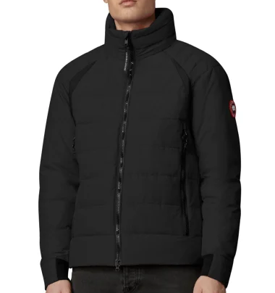
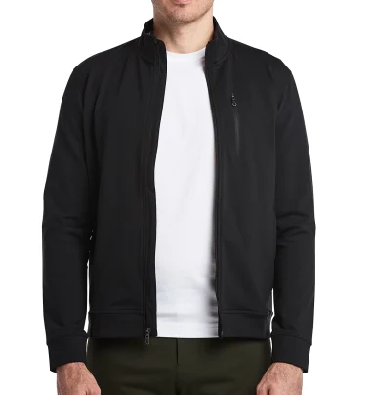
With BR, different jackets are ranked #1 based on Segment AND Query
black jacket
black jacket
black jacket
LUXURY
FUNCTIONAL
LOYAL
Notes:
BloomReach discovery takes that query and understands the relation of the query to products. If you’re using Discovery already, your customers will see the product with that has the highest expected revenue per visit. That's that's the metric that Discovery optimizes against.
However, all your customers will see the same results. Even though they might be behaviourally different, thus belonging to different segments. One might be a deal hunter, the other be a premium buyer. And the third one is a trendsetter. But they would all see the same dress in position #1.
[next slide]

Slide 25
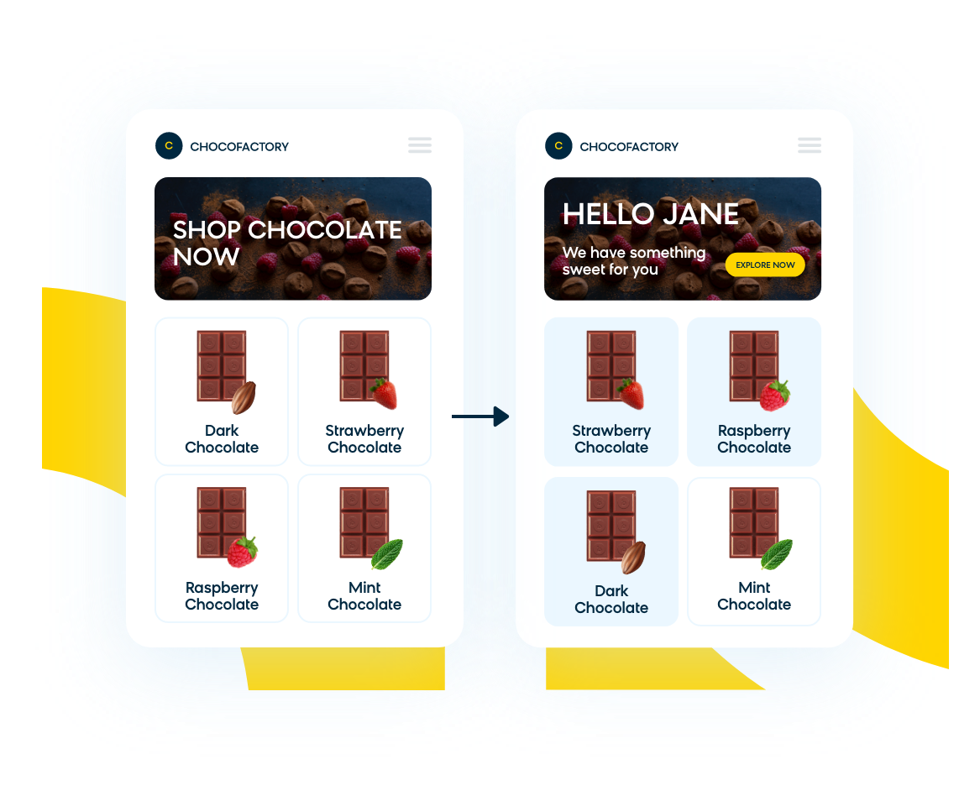
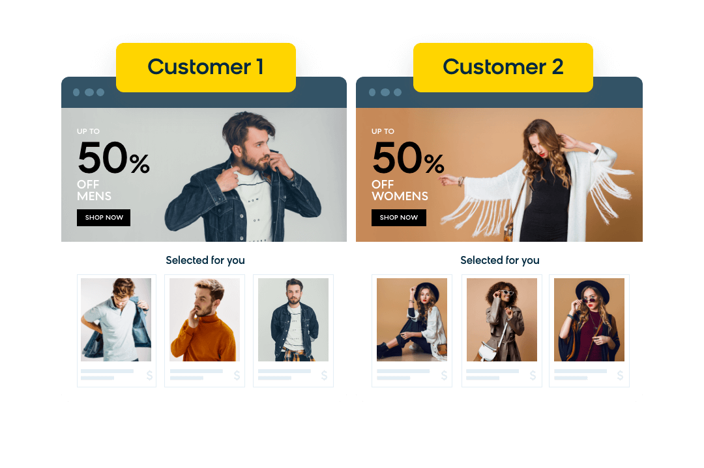
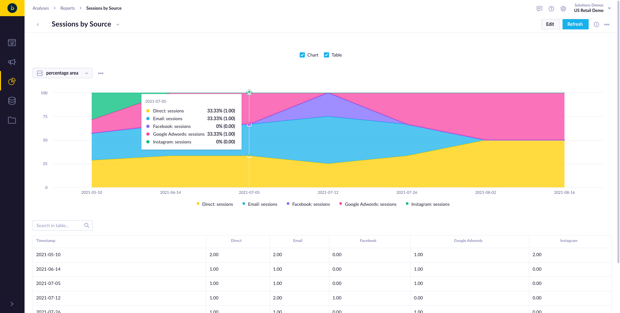
Core Strengths and Value Adds
Business User Friendly Management & Analytics
Real-time Personalization for Logged-in & Anonymous
In-session Changes
Maximizing Revenue
Notes:
Distinct Segments Based on Behaviour - Segments for RTCS and the personalized ranking are based on differences in customer behaviour, not only surface level differences in demographics.
Unprecedented On-site Traffic Coverage- Thanks to real-time data collection, and segments informed by on-site behaviour we’re able to segment 50+% of overall traffic, including in-session segment switching.
Real-time Analytics - Real-time analytics enable you to continuously report back on which segments are performing, and which are not to continuously refine your ongoing segment strategy.
OOTB AB Testing - Combined with Real-time Analytics - Quickly determine which segments drive more revenue, which segments don’t and continuously adjust your strategy.
Business User Friendly - No developers required for ongoing management of maintenance, new Segment testing, or Exposing Segmented Search to all site traffic.
Relentless Focus on Maximizing Revenue - Discovery optimize for revenue with the added knowledge of customer segments. Segments inform the best possible ranking, and allow for even more relevant search results and higher RPV.

Slide 26
Revenue Uplift
Discovery impacts the KPIs which drive ecommerce and economic success for online retailers.
These figures are typical improvements seen across the board from retailers moving to Discovery.
You have the opportunity to influence:
Search Improvements
Enhanced Merchandising
Custom Recommendations
Relevance by Segment
+15%
RPV
+3%
RPV
+5%
AOV
+2%
Conv
Bloomreach
Relevance
Merchandise
by Exception
Recommendations
Using Pixel Data
Personalisation
via Pixel Data

Slide 27
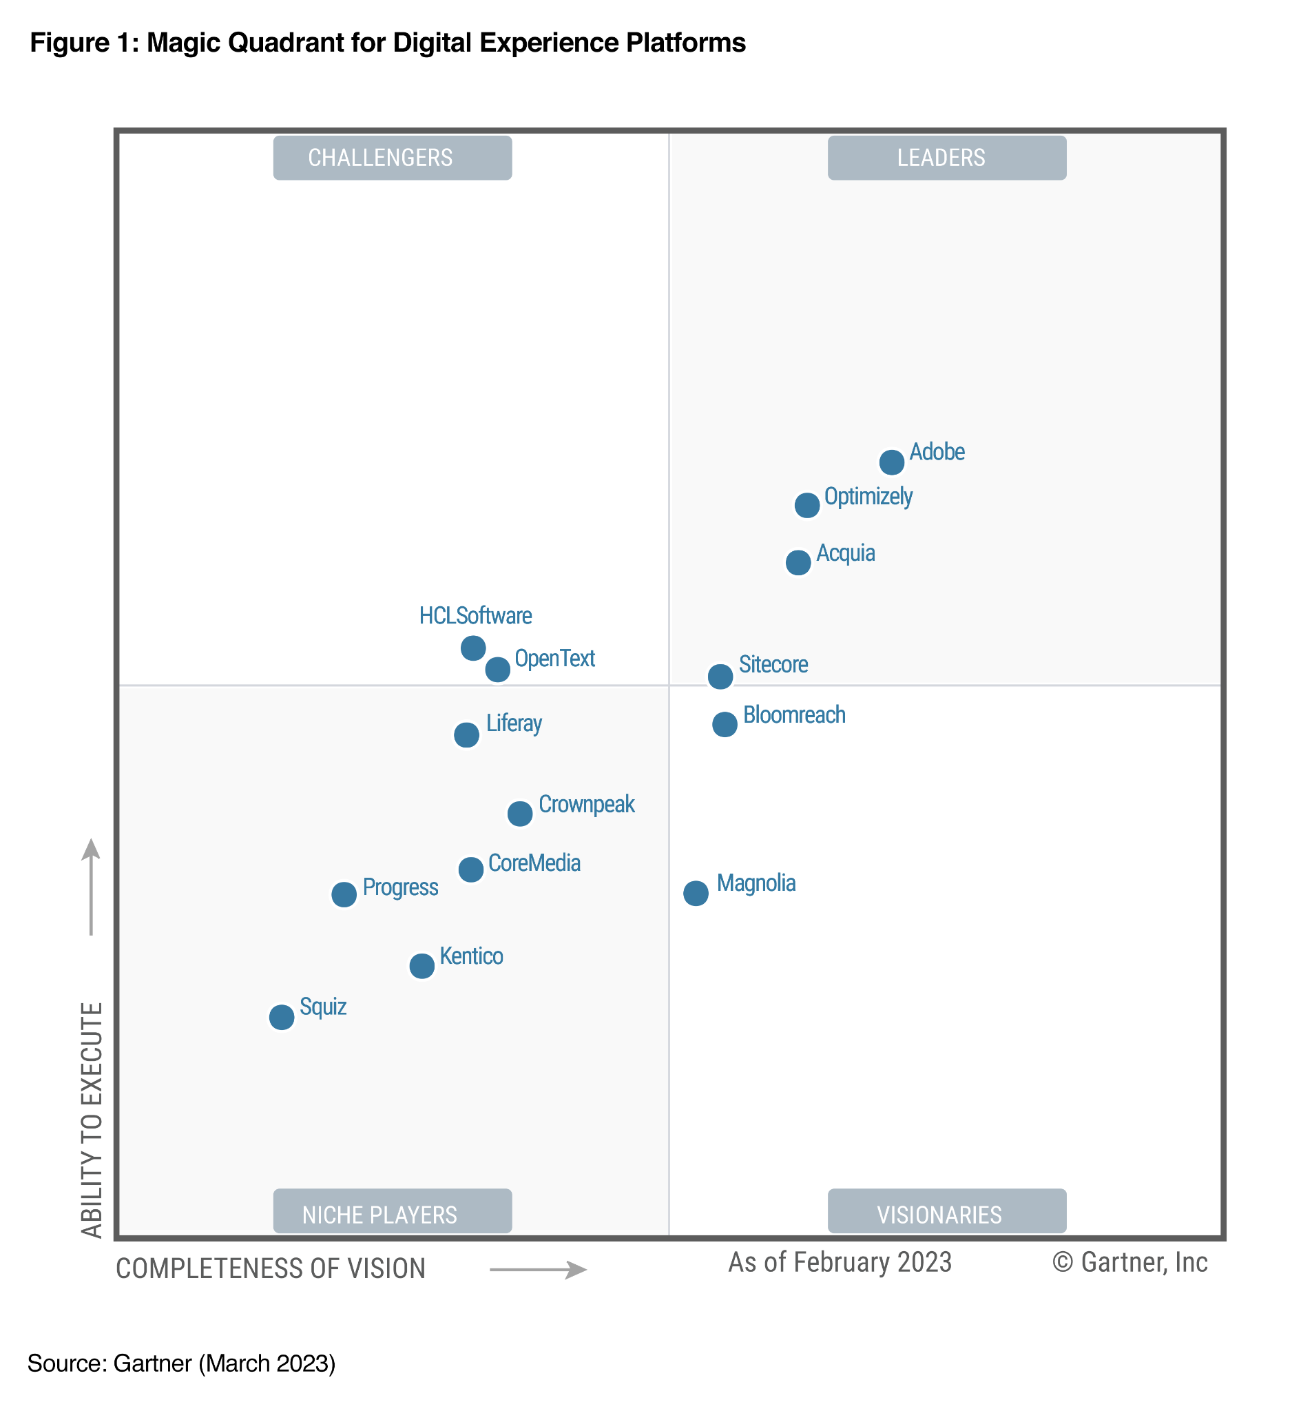
Bloomreach is
the first and only
MACH certified DXP
in Gartner Magic Quadrant for
Digital Experience Platforms, 2023

Slide 28
Thank you!

