Slide 1
Nowy wymiar zarządzania łańcuchem dostaw z wykorzystaniem Sztucznej Inteligencji
Piotr Rozenbajgier
Piotr.Rozenbajgier@sas.com

Slide 2
Please describe Artificial Intelligence
chatGPT:
Artificial Intelligence
Artificial Intelligence, or AI, refers to the development of computer systems and algorithms that are capable of performing tasks that typically require human intelligence.
This includes a range of different areas such as machine learning, natural language processing, image recognition, planning, optimization, and more.
AI systems are able to recognize patterns, analyze data, learn from experience, and make decisions based on the information they process.
Some of the key features of AI systems include their ability to learn, adapt, automate tasks, recognize patterns, and make decisions.

Slide 3
5 Artificial Intelligence characteristics
chatGPT: Certainly! Here are five characteristics of AI:
Learning
Artificial intelligence has the ability to learn from data and improve its performance over time.
Problem-solving
AI can analyze data and solve complex problems in a way that's faster and more accurate than humans.
Pattern recognition
AI can identify patterns and trends in large datasets, which can help organizations make more informed decisions.
Adaptability
AI systems can adjust to new data and changing circumstances, making them more flexible than traditional computer programs.
Autonomy
Some AI systems can operate with little to no human intervention, which can be useful for tasks that are dangerous or difficult for humans to perform.

Slide 4
Artificial intelligence in everyday life
Source: https://www.pngegg.com

Slide 5
Data Alone Doesn’t Drive Your Organization….Decisions Do
Operationalizing Analytics
Data
Analytical Insight
Decisions
Impact
Analytically Driven Decisions are Better

Slide 6
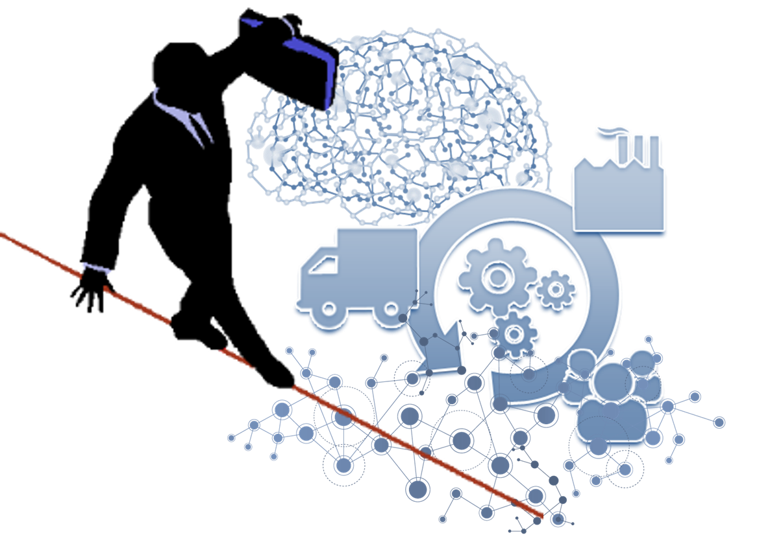
Supply Chain Management
Do we know our supply chain?
Do we all understand our strategy?
Do we have a plan and know how to execute it?
source: https://www.pngwing.com

Slide 7
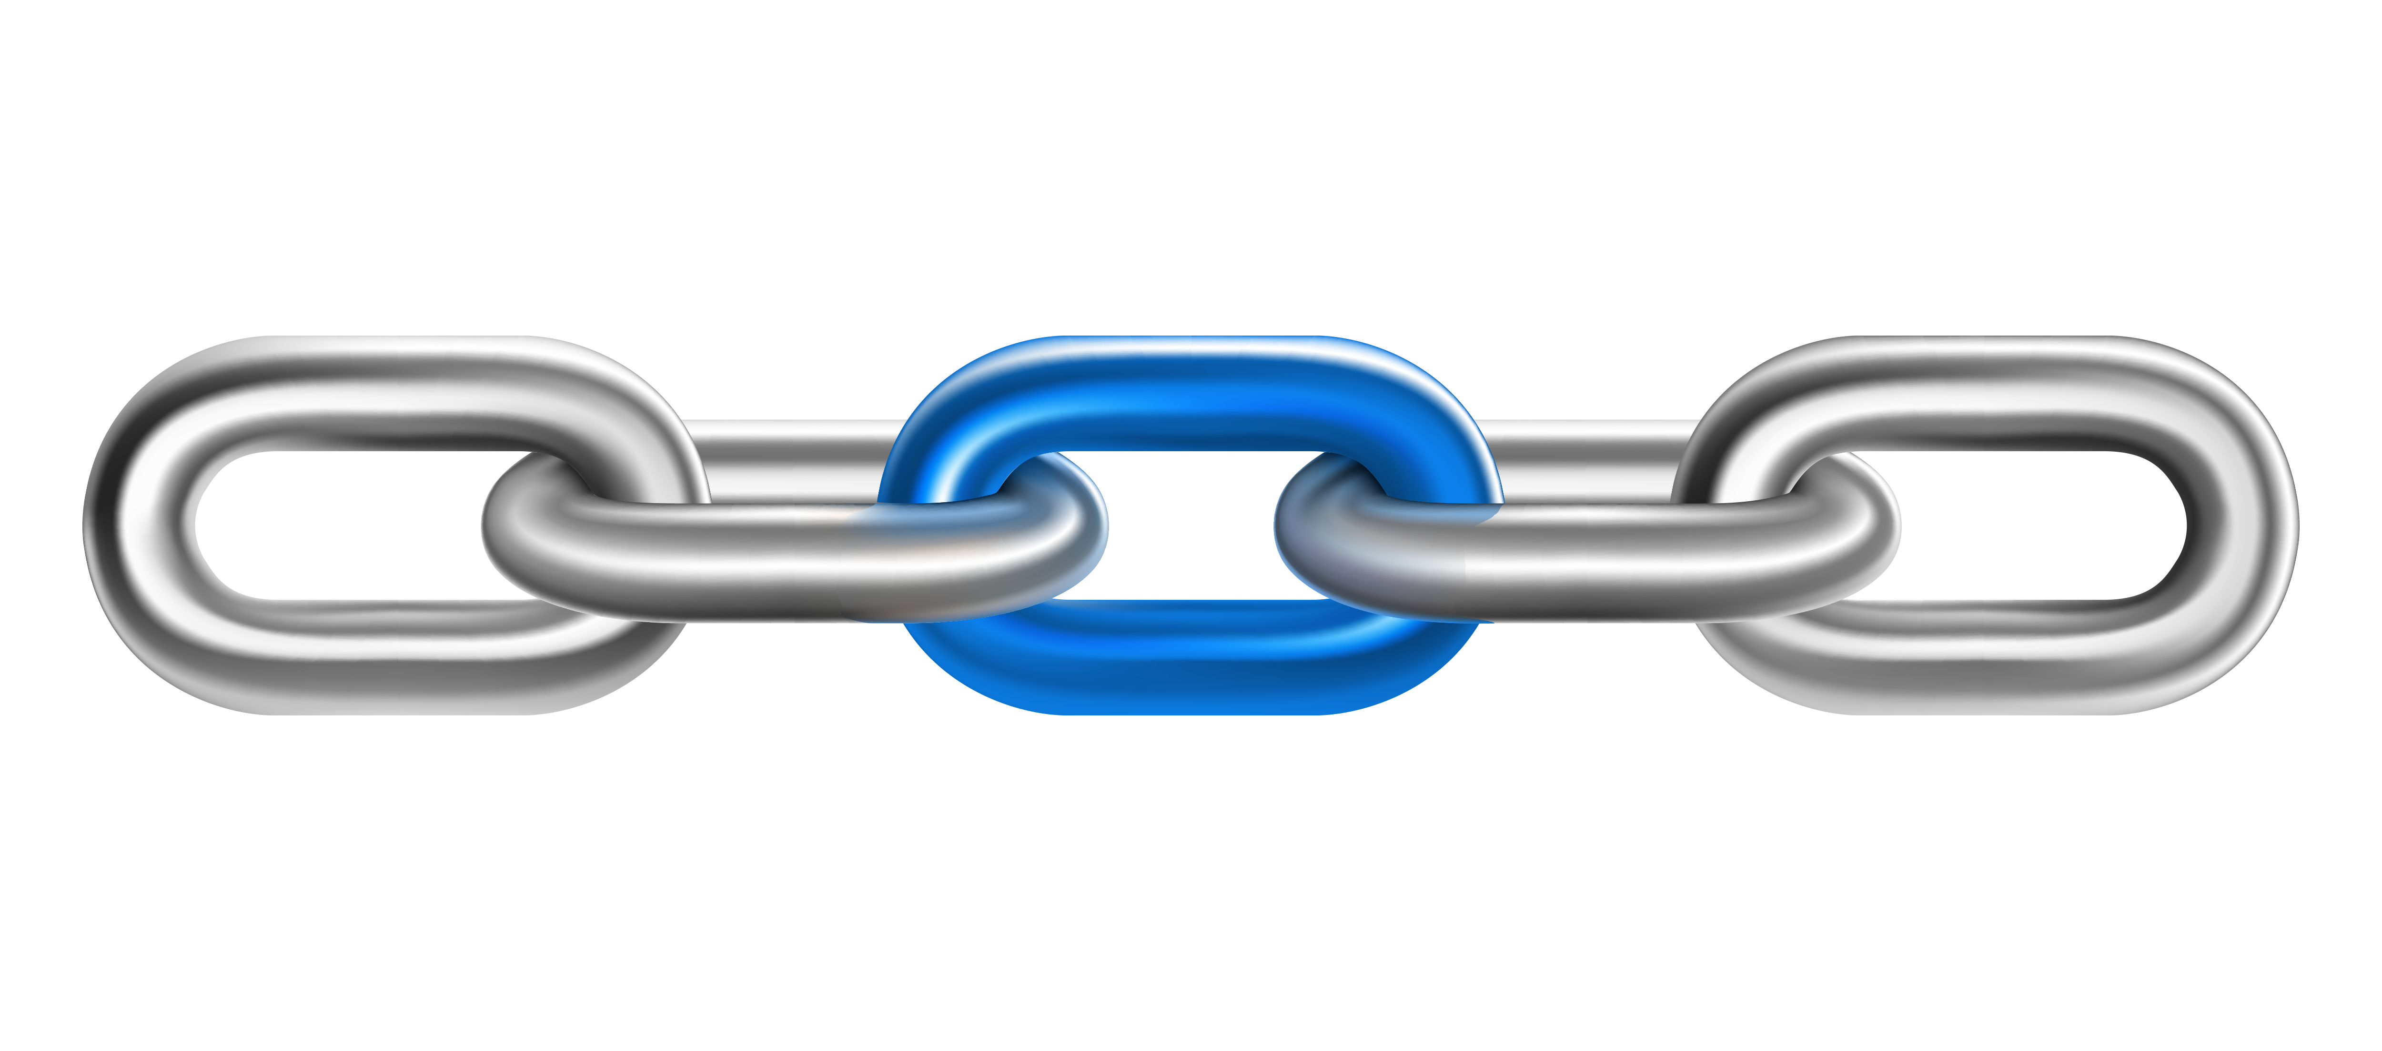
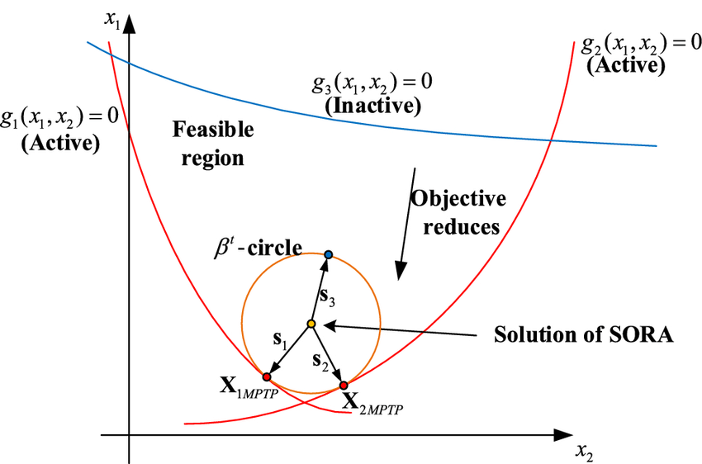
Do we know our supply chain?
How strong/weak is it?
What are active constraints?
Source: https://www.pngegg.com

Slide 8
Supply Chain Management
Strategy & Plan
Joint actions to achieve common goal.
Decision impact: butterfly effect
Source: https://www.pngegg.com

Slide 9
Ways to improve
Lean
Six Sigma
Theory of constraints
Technology

Slide 10
How AI could help?
Forecast: demand, production, inventory, transport
Scheduling: production, transport, workforce
Optimization: inventory, replenishment, pack-size, transport
Fraud prevention: invoice, price override, loyalty programs
Customer needs: segmentation, prediction, promotion, loyalty

Slide 11
The Road to Analytics-Driven Supply Chain
Management Maturity Model
Competitive advantage
Technology
Artificial Intelligence,
Analytics-Driven
Most companies are here!
POS Data
Causal Analysis
External Collaboration
ML Models
Optimization
Scheduling
Demand Forecasting
Collaborative Planning,
No Advanced Analytics,
Rule based systems
Ad hoc Forecasting,
No Coodination,
Rules of thumb
Some companies think this is the end!
Judgment
Requires
Forecasting
Software
Requires
Analytics
Advanced Analytics
Notes:
As we know most companies limit their forecasts to trending versus last year or traditional time series forecasting. Time series models can provide good a forecasts in stable environments for stable products. However, that is not the world we live in. Additionally, even in times with less disruption, time series models can require a lot of data cleansing.
SAS addresses both of these challenges by
Eliminating the need to pre cleanse data
Automating the selection of the most appropriate algorithm for a time series
Introducing hierarchical forecasting reconciliation
And classifying of TS based on historical pattern
Additionally, SAS forecasts can be made even stronger with the introduction of POS, Causal and External data. Finally, SAS does not stop with time series. Our forecasting package includes ML models that can prove to be helpful for volatile or sparse data situations.

Slide 12
5 focus areas of SAS Institute
chatGPT:
2. Data Management and Integration
3. Fraud and Risk Management
5. Customer Intelligence and Experience
5. Internet of Things (IoT) and Streaming Analytics
1. Analytics and Artificial Intelligence:
1. Analytics and Artificial Intelligence: SAS is a leader in providing advanced analytics and artificial intelligence solutions for businesses, including machine learning, predictive analytics, natural language processing, and computer vision.

Slide 13
ANALYTICS
FOR EVERYONE.
EVERYWHERE.
Questions?
Notes:
Key point: to transform a world of data into a world of intelligence, we need to bring analytics to everyone, and everywhere.
Speaking points:
At SAS, we look at our efforts through the following lens: Analytics for Everyone. And Analytics Everywhere.
Just imagine this - everyone in your organization is actively using data to make better decisions. We are entering a low-code / no-code era – through drag-and-drop interfaces we give those with ideas and deep business domain understanding the power to run various scenarios, to explore WHAT IFs – without always having to go through IT or data scientists experts. And as for “everywhere”, we want to bring analytics wherever there is data. Which means we need to enable analytics across all data environments and paradigms - on-premise, cloud, hybrid, through API’s, in real-time, in database, on server, on edge. Why should you care about this? You might have heard us say this before: data without analytics is value not yet realized. IDC estimates about 4,800 interactions with connected devices by 2025. This gives you the chance to provide the right product, the best answer, to make the engagement of your customer with your brand not only frictionless, but inspiring. Without some form of analytics behind those interactions, the value will be marginal at best.

